Slide 1
Measles and Rubella
Global Update
March 2026

Slide 2
Distribution list
This report is posted on the WHO Immunization data portal (https://immunizationdata.who.int/global?topic=Provisional-measles-and-rubella-data&location=) and distributed by email on a monthly basis.
To join the distribution list, please send an email to Sebastien Antoni (antonis@who.int)

Slide 3
Disclaimer
Please note that all data contained within is provisional. The number of cases of measles and rubella officially reported by a member state is only available by July of each year (through the joint WHO UNICEF annual data collection exercise). If any numbers from this provisional data are quoted, they should be properly sourced with a date (i.e. "provisional data based on monthly data reported to WHO (Geneva) as of March 2026"). For official data from 1980-2024, please visit our website.

Slide 4
Data sources and limitations

Slide 5
Measles

Slide 6
Number of reported measles cases by WHO Region
2026
Region | Member States* | Suspected MR cases | Measles cases | Clin | Epi | Lab | Date Received
AFR | 34/47 | 11,576 | 7,193 | 2,507 | 2,369 | 2,317 | 2026-03
AMR | 22/35 | 21,142 | 8,814 | 0 | 202 | 8,612 | 2026-03
EMR | 16/21 | 6,283 | 3,189 | 707 | 1,014 | 1,468 | 2026-03
EUR | 32/53 | 3,863 | 2,816 | 220 | 86 | 2,510 | 2026-03
SEAR | 7/10 | 15,313 | 6,726 | 2,663 | 446 | 3,617 | 2026-03
WPR | 22/28 | 4,113 | 1,819 | 11 | 1,279 | 529 | 2026-03
Total | 133/194 | 62,290 | 30,557 | 6,108 | 5,396 | 19,053
Region | Jan | Feb | Mar | Apr | May | Jun | Jul | Aug | Sep | Oct | Nov | Dec
AFR | 4,613 | 2,580 | 0 | 0 | 0 | 0 | 0 | 0 | 0 | 0 | 0 | 0
AMR | 3,514 | 4,870 | 430 | 0 | 0 | 0 | 0 | 0 | 0 | 0 | 0 | 0
EMR | 2,918 | 262 | 9 | 0 | 0 | 0 | 0 | 0 | 0 | 0 | 0 | 0
EUR | 2,640 | 176 | 0 | 0 | 0 | 0 | 0 | 0 | 0 | 0 | 0 | 0
SEAR | 3,875 | 2,851 | 0 | 0 | 0 | 0 | 0 | 0 | 0 | 0 | 0 | 0
WPR | 1,202 | 614 | 3 | 0 | 0 | 0 | 0 | 0 | 0 | 0 | 0 | 0
Total | 18,762 | 11,353 | 442 | 0 | 0 | 0 | 0 | 0 | 0 | 0 | 0 | 0
2025
Region | Member States* | Suspected MR cases | Measles cases | Clin | Epi | Lab | Date Received
AFR | 42/47 | 145,789 | 88,460 | 40,184 | 21,113 | 27,163 | 2026-03
AMR | 32/35 | 42,294 | 14,477 | 2 | 2,880 | 11,595 | 2026-03
EMR | 20/21 | 130,075 | 75,508 | 32,898 | 12,012 | 30,598 | 2026-03
EUR | 47/53 | 50,316 | 34,020 | 4,878 | 5,507 | 23,635 | 2026-03
SEAR | 10/10 | 109,824 | 20,011 | 4,265 | 4,304 | 11,442 | 2026-03
WPR | 28/28 | 134,476 | 43,764 | 3,847 | 12,439 | 27,478 | 2026-03
Total | 179/194 | 612,774 | 276,240 | 86,074 | 58,255 | 131,911
Region | Jan | Feb | Mar | Apr | May | Jun | Jul | Aug | Sep | Oct | Nov | Dec
AFR | 8,046 | 9,196 | 11,663 | 8,463 | 8,980 | 7,734 | 6,718 | 6,941 | 6,164 | 6,060 | 4,724 | 3,771
AMR | 211 | 436 | 1,221 | 2,516 | 2,178 | 1,883 | 1,659 | 883 | 739 | 631 | 743 | 1,377
EMR | 6,990 | 7,729 | 9,501 | 9,588 | 9,044 | 6,295 | 6,129 | 4,563 | 3,967 | 4,044 | 3,833 | 3,825
EUR | 4,906 | 4,463 | 4,525 | 5,284 | 5,245 | 3,872 | 1,763 | 826 | 506 | 482 | 699 | 1,449
SEAR | 1,369 | 1,571 | 2,051 | 2,114 | 1,646 | 1,191 | 1,239 | 914 | 1,256 | 1,746 | 2,091 | 2,823
WPR | 2,627 | 2,723 | 2,425 | 2,333 | 5,528 | 8,146 | 4,854 | 4,594 | 4,211 | 3,704 | 1,760 | 859
Total | 24,149 | 26,118 | 31,386 | 30,298 | 32,621 | 29,121 | 22,362 | 18,721 | 16,843 | 16,667 | 13,850 | 14,104
Notes: Based on data received 2026-03 - This is surveillance data, hence for the last month, the data may be incomplete. * Member States Reporting / Total Member States in Region

Slide 7


Measles/rubella verification of elimination
Measles
Region | Member States | Verified | % Verified | Eliminated | Endemic* | Not classified
AFR | 47 | 3 | 6 | 0 | 44 | 0
AMR | 35 | 33 | 94 | 0 | 1 | 1
EMR | 21 | 4 | 19 | 0 | 17 | 0
EUR | 53 | 32 | 60 | 1 | 19 | 1
SEAR | 10 | 4 | 40 | 0 | 6 | 0
WPR | 28 | 19 | 68 | 1 | 8 | 0
GLOBAL | 194 | 95 | 49 | 2 | 95 | 2
Rubella
Region | Member States | Verified | % Verified | Eliminated | Endemic* | Not classified
AFR | 47 | 3 | 6 | 0 | 44 | 0
AMR | 35 | 34 | 97 | 0 | 0 | 1
EMR | 21 | 4 | 19 | 0 | 17 | 0
EUR | 53 | 49 | 92 | 0 | 0 | 4
SEAR | 10 | 6 | 60 | 0 | 4 | 0
WPR | 28 | 19 | 68 | 2 | 7 | 0
GLOBAL | 194 | 115 | 59 | 2 | 72 | 5
Notes: Based on data available at WHO HQ as of 2026-03-16 . Terms used on this slide refer to the global framework for the verification of measles and rubella elimination. These terms might differ from those used by WHO Regional Offices. Verified = Elimination verified by Regional Verification Commission (RVC); Eliminated = Eliminated transmission but no RVC verification yet; *The endemic category on this slide also includes countries where transmission was reestablished.

Slide 8
Measles case distribution by month and WHO Region (2021-2026)
2021
2022
2023
2024
2025
2026
59,619 cases
176,408 cases
321,876 cases
359,450 cases
276,240 cases
30,557 cases
60,000
40,000
AFR
AMR
EMR
EUR
SEAR
WPR
20,000
0
Jan
Feb
Mar
Apr
May
Jun
Jul
Aug
Sep
Oct
Nov
Dec
Jan
Feb
Mar
Apr
May
Jun
Jul
Aug
Sep
Oct
Nov
Dec
Jan
Feb
Mar
Apr
May
Jun
Jul
Aug
Sep
Oct
Nov
Dec
Jan
Feb
Mar
Apr
May
Jun
Jul
Aug
Sep
Oct
Nov
Dec
Jan
Feb
Mar
Apr
May
Jun
Jul
Aug
Sep
Oct
Nov
Dec
Jan
Feb
Mar
Apr
May
Jun
Jul
Aug
Sep
Oct
Nov
Dec
Based on data received 2026-03 - Data Source: IVB Database - This is surveillance data, hence for the last month(s), the data may be incomplete.

Slide 9
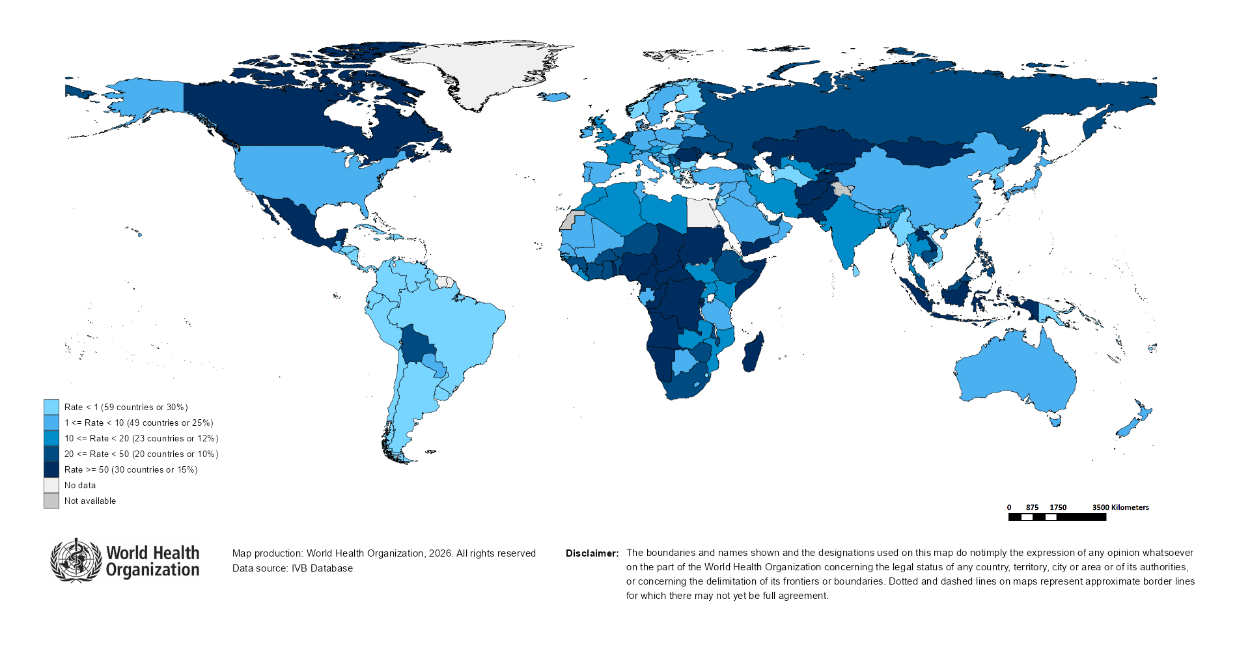
Measles Incidence Rate per Million (12M period)
Highest incidence rates | Highest incidence rates | Highest incidence rates
Country | Cases | Rate
Mongolia | 13293 | 3,779.53
Kyrgyzstan | 6582 | 902.26
Yemen | 29488 | 705.90
Lao People's Democratic Republic | 4720 | 599.51
Angola | 21955 | 562.37
Cameroon | 9104 | 304.69
Kazakhstan | 6120 | 293.61
Central African Republic | 1461 | 265.00
Tajikistan | 2255 | 209.05
Afghanistan | 8806 | 200.85
Notes: Based on data received 2026-03 - Surveillance data from 2025-02 to 2026-01 - Incidence: Number of cases / population * 1,000,000 - Population data: World population prospects, 2019 revision

Slide 10
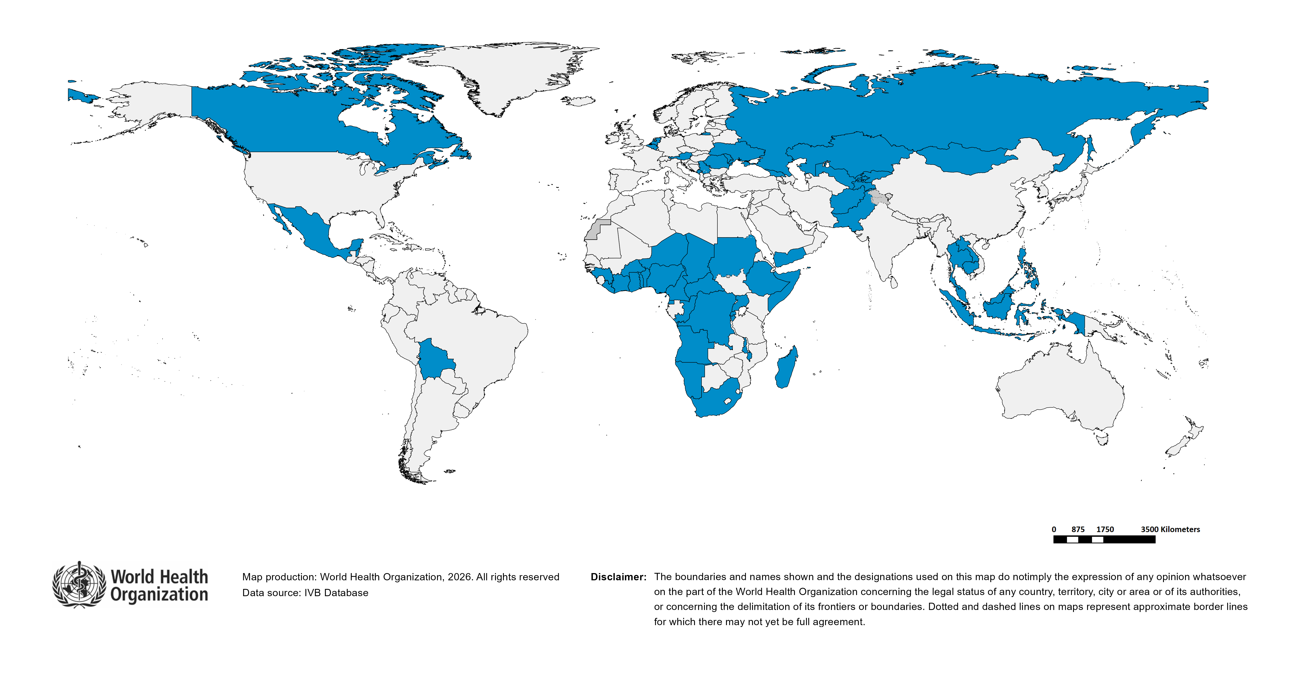
Immunization Agenda 2030 - Impact Goal 1.3
Countries provisionally meeting the large or disruptive outbreaks definition - Data from 2024-11 to 2025-10 included
Country | Cases | Rate/M | Clinical*
Mongolia | 13,014 | 3,700.21 | 0%
Kyrgyzstan | 9,855 | 1,350.92 | 43%
Yemen | 32,760 | 784.22 | 87%
Angola | 20,262 | 519.01 | 81%
Lao People's Democratic Republic | 2,612 | 331.76 | 0%
Romania | 5,979 | 316.20 | 4%
Afghanistan | 10,679 | 243.57 | 0%
Tajikistan | 2,241 | 207.76 | 0%
Cameroon | 6,196 | 207.37 | 4%
Central African Republic | 1,058 | 191.90 | 1%
Congo | 1,040 | 160.38 | 2%
Georgia | 587 | 154.20 | 14%
Kazakhstan | 2,978 | 142.87 | 6%
Sudan | 6,625 | 128.24 | 1%
Canada | 4,899 | 122.09 | 0%
Rwanda | 1,654 | 113.53 | 91%
Togo | 1,059 | 108.93 | 3%
Burundi | 1,515 | 105.28 | 2%
Belize | 42 | 99.31 | 5%
Somalia | 1,863 | 94.79 | 0%
Cambodia | 1,590 | 89.09 | 0%
Nigeria | 19,447 | 81.87 | 75%
Equatorial Guinea | 158 | 81.51 | 10%
Serbia | 540 | 80.73 | 60%
Pakistan | 19,796 | 77.56 | 20%
Namibia | 225 | 72.75 | 30%
Republic of Moldova | 203 | 67.75 | 3%
Country | Cases | Rate/M | Clinical*
DR Congo | 7,405 | 65.63 | 5%
Madagascar | 2,139 | 65.33 | 87%
Indonesia | 17,406 | 60.92 | 2%
Ethiopia | 6,857 | 50.62 | 1%
Guinea | 702 | 46.49 | 10%
Russian Federation | 6,666 | 46.29 | 0%
Malawi | 1,019 | 45.87 | 3%
Niger | 1,268 | 45.42 | 19%
Philippines | 5,119 | 43.83 | 71%
Benin | 648 | 43.74 | 16%
Chad | 910 | 43.33 | 4%
Ghana | 1,481 | 42.24 | 86%
Ukraine | 1,610 | 41.30 | 7%
Mexico | 5,204 | 39.44 | 0%
Bolivia (Plurinational State of) | 460 | 36.56 | 0%
South Africa | 2,316 | 35.77 | 23%
Malaysia | 1,207 | 33.55 | 19%
Belgium | 388 | 33.00 | 9%
Côte d'Ivoire | 1,067 | 32.62 | 0%
Montenegro | 20 | 31.61 | 0%
Netherlands (Kingdom of the) | 568 | 30.96 | 0%
Thailand | 2,203 | 30.76 | 43%
Burkina Faso | 680 | 28.25 | 23%
Uzbekistan | 932 | 25.15 | 1%
Uganda | 1,177 | 22.91 | 5%
Austria | 188 | 20.63 | 0%
Liberia | 116 | 20.24 | 0%
Total: 54 countries
In the frame of tracking progress towards the goals of Immunization Agenda 2030 (IA2030), an indicator has been developed by a working group in order to represent large or disruptive measles outbreaks. This indicator is defined as an incidence equal or greater than 20 reported measles cases per million population over a period of 12 months. It is important to note that measles outbreak definitions vary between countries and regions according to local context and level of progress towards regional elimination goals. This definition of large or disruptive outbreaks aims to complement and not replace the national and regional definitions, while also providing a degree of global standardization and permitting tracking of progress against a common metric.
Notes: Based on data received 2026-03 and covering the period between 2024-11 and 2025-10 - Incidence: Number of cases / 1M population - Population Data: World population prospects, 2019 revision - A high proportion of clinical cases indicates a high level of uncertainty associated with the incidence rates and the inclusion of countries in this list.

Slide 11
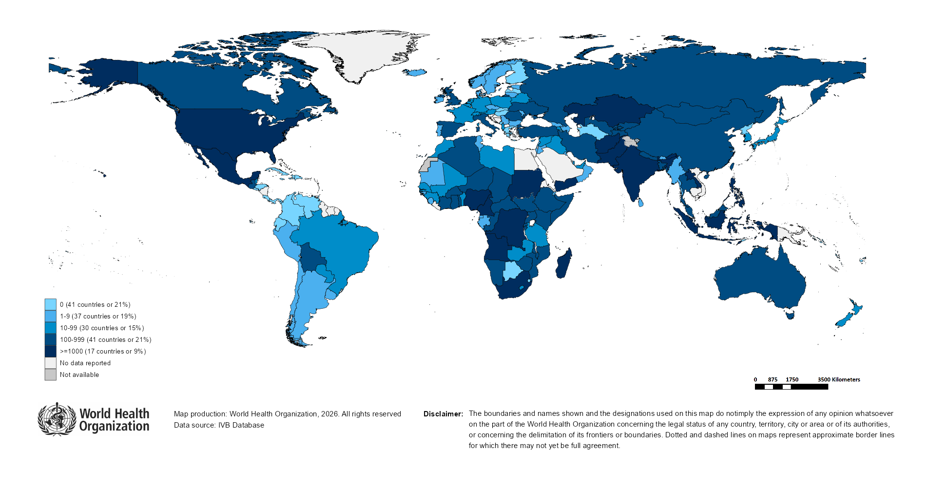
Number of Reported Measles Cases (Last 6 months)
Country | Cases*
India** | 12,135
Angola | 11,941
Indonesia | 8,892
Yemen | 8,507
Pakistan | 7,527
Cameroon | 5,088
Mexico | 4,636
Sudan | 4,071
Kazakhstan | 3,826
Lao People's Democratic Republic | 3,565
Notes: Based on data received 2026-03 - Surveillance data from 2025-08 to 2026-01 - * Countries with highest number of cases for the period - **WHO classifies all suspected measles cases reported from India as measles clinically compatible if a specimen was not collected as per the algorithm for classification of suspected measles in the WHO VPD Surveillance Standards. Thus numbers might be different between what WHO reports and what India reports.

Slide 12
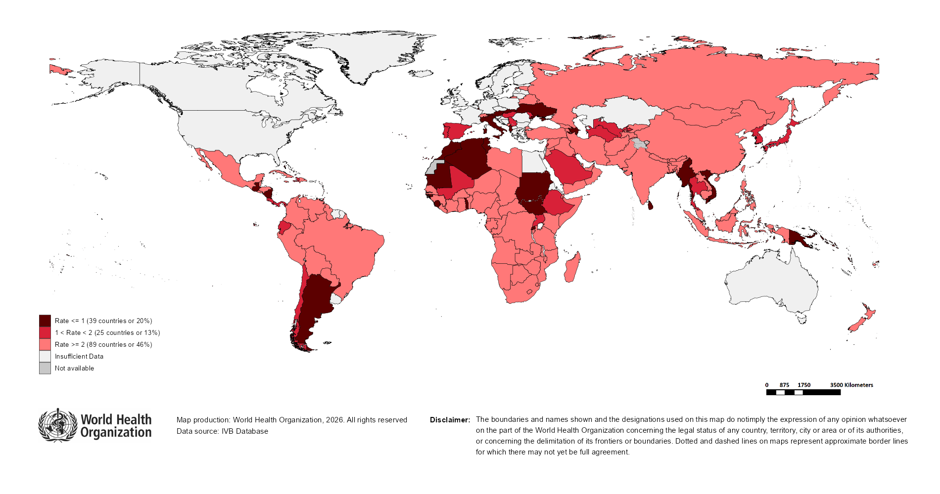
Surveillance sensitivity reporting rate of measles and rubella (12 months, discarded cases* per 100,000 population)
Notes: Based on data received 2026-03 - Surveillance data from 2025-02 to 2026-01 - Target: >= 2 discarded cases* / 100,000 population** - * Suspected cases investigated and discarded as non-measles non-rubella using laboratory testing and/or epidemiological linkage to another etiology ** World population prospects, 2019 revision

Slide 13
Disclaimer
This document contains data provided to WHO by member states. Note that some member states only provide aggregate data to WHO, and for these, we are unable to generate a country profile. Some member states report all cases at one time point for the entire year, and thus epidemiologic curves generated are not accurate and a reporting artifact. For some countries, cases are reported by age category, not by exact age in months and/or years. Thus, age distribution/incidence is approximate. Cases classified as pending by countries are classified at WHO as clinically compatible at this time, and thus numbers might different between data shown here and provided by the member state or WHO country/regional offices.
*UN population data is used as the denominator for calculating incidence.

Slide 14
Measles case distribution (AFR), 2021-2026
2021
2022
2023
2024
2025
2026
20,000
26,492 cases
66,990 cases
73,443 cases
86,127 cases
88,460 cases
7,193 cases
15,000
10,000
5,000
0
Jan
Feb
Mar
Apr
May
Jun
Jul
Aug
Sep
Oct
Nov
Dec
Jan
Feb
Mar
Apr
May
Jun
Jul
Aug
Sep
Oct
Nov
Dec
Jan
Feb
Mar
Apr
May
Jun
Jul
Aug
Sep
Oct
Nov
Dec
Jan
Feb
Mar
Apr
May
Jun
Jul
Aug
Sep
Oct
Nov
Dec
Jan
Feb
Mar
Apr
May
Jun
Jul
Aug
Sep
Oct
Nov
Dec
Jan
Feb
Mar
Apr
May
Jun
Jul
Aug
Sep
Oct
Nov
Dec
Angola
Cameroon
DR Congo
Ethiopia
Nigeria
Others
Based on data received 2026-03 - Data Source: IVB Database

Slide 15
Measles cases: Angola
ELIMINATION STATUS:
ENDEMIC
2022
2023
2024
2025
2026
4,000
Total: 3,263 case(s)
Total: 2,475 case(s)
Total: 568 case(s)
Total: 22,538 case(s)
Total: 2,017 case(s)
Discarded
JRF: 3,271 case(s)
JRF: 3,508 case(s)
JRF: 619 case(s)
Not reported
Clinical
Epi
3,000
Lab
Number of measles cases
2,000
1,000
0
Jan
Feb
Mar
Apr
May
Jun
Jul
Aug
Sep
Oct
Nov
Dec
Jan
Feb
Mar
Apr
May
Jun
Jul
Aug
Sep
Oct
Nov
Dec
Jan
Feb
Mar
Apr
May
Jun
Jul
Aug
Sep
Oct
Nov
Dec
Jan
Feb
Mar
Apr
May
Jun
Jul
Aug
Sep
Oct
Nov
Dec
Jan
Feb
Mar
Apr
May
Jun
Jul
Aug
Sep
Oct
Nov
Dec
Age distribution, vaccination status and incidence (last 12 months)
WHO/UNICEF Coverage Estimates (WUENIC)
4000
100
9,000
3000
80
6,000
2000
60
Number of cases
Incidence rate per M
% Coverage
3,000
1000
40
0
0
20
<1 yr
1-4 yrs
5-9 yrs
10-14 yrs
15-24 yrs
25-39 yrs
40+ yrs
0
Age at onset (in years)
2000
2001
2002
2003
2004
2005
2006
2007
2008
2009
2010
2011
2012
2013
2014
2015
2016
2017
2018
2019
2020
2021
2022
2023
2024
Incidence
2+ doses
1 dose
0 doses
Unknown
MCV1
MCV2
Based on data received 2026-03 - Data Source: IVB Database. Main epi curve was built using case-based surveillance data. Age distribution curve was built using case-based surveillance data. Coverage data from WHO/UNICEF Estimates of National Immunization Coverage (WUENIC)

Slide 16
Measles cases: Burundi
ELIMINATION STATUS:
ENDEMIC
2022
2023
2024
2025
2026
800
Total: 222 case(s)
Total: 1,694 case(s)
Total: 2,616 case(s)
Total: 1,566 case(s)
Total: 444 case(s)
SIA
JRF: 212 case(s)
JRF: 1,684 case(s)
JRF: 2,741 case(s)
Not reported
600
Discarded
Clinical
Epi
Number of measles cases
Lab
400
200
0
Jan
Feb
Mar
Apr
May
Jun
Jul
Aug
Sep
Oct
Nov
Dec
Jan
Feb
Mar
Apr
May
Jun
Jul
Aug
Sep
Oct
Nov
Dec
Jan
Feb
Mar
Apr
May
Jun
Jul
Aug
Sep
Oct
Nov
Dec
Jan
Feb
Mar
Apr
May
Jun
Jul
Aug
Sep
Oct
Nov
Dec
Jan
Feb
Mar
Apr
May
Jun
Jul
Aug
Sep
Oct
Nov
Dec
Age distribution, vaccination status and incidence (last 12 months)
WHO/UNICEF Coverage Estimates (WUENIC)
600
1500
100
1000
80
400
Number of cases
Incidence rate per M
60
200
500
% Coverage
40
0
0
20
<1 yr
1-4 yrs
5-9 yrs
10-14 yrs
15-24 yrs
25-39 yrs
40+ yrs
0
Age at onset (in years)
2000
2001
2002
2003
2004
2005
2006
2007
2008
2009
2010
2011
2012
2013
2014
2015
2016
2017
2018
2019
2020
2021
2022
2023
2024
Incidence
2+ doses
1 dose
0 doses
Unknown
MCV1
MCV2
Based on data received 2026-03 - Data Source: IVB Database. Main epi curve was built using case-based surveillance data. Age distribution curve was built using case-based surveillance data. Coverage data from WHO/UNICEF Estimates of National Immunization Coverage (WUENIC)

Slide 17
Measles cases: Cameroon
ELIMINATION STATUS:
ENDEMIC
2022
2023
2024
2025
2026
2,000
Total: 3,449 case(s)
Total: 6,175 case(s)
Total: 869 case(s)
Total: 8,270 case(s)
Total: 1,564 case(s)
SIA
JRF: 3,217 case(s)
JRF: 6,105 case(s)
JRF: 863 case(s)
Not reported
1,500
Discarded
Clinical
Epi
Number of measles cases
Lab
1,000
500
0
Jan
Feb
Mar
Apr
May
Jun
Jul
Aug
Sep
Oct
Nov
Dec
Jan
Feb
Mar
Apr
May
Jun
Jul
Aug
Sep
Oct
Nov
Dec
Jan
Feb
Mar
Apr
May
Jun
Jul
Aug
Sep
Oct
Nov
Dec
Jan
Feb
Mar
Apr
May
Jun
Jul
Aug
Sep
Oct
Nov
Dec
Jan
Feb
Mar
Apr
May
Jun
Jul
Aug
Sep
Oct
Nov
Dec
Age distribution, vaccination status and incidence (last 12 months)
WHO/UNICEF Coverage Estimates (WUENIC)
1500
100
4,000
3,000
80
1000
60
Number of cases
2,000
Incidence rate per M
500
% Coverage
1,000
40
0
0
20
<1 yr
1-4 yrs
5-9 yrs
10-14 yrs
15-24 yrs
25-39 yrs
40+ yrs
0
Age at onset (in years)
2000
2001
2002
2003
2004
2005
2006
2007
2008
2009
2010
2011
2012
2013
2014
2015
2016
2017
2018
2019
2020
2021
2022
2023
2024
Incidence
2+ doses
1 dose
0 doses
Unknown
MCV1
MCV2
Based on data received 2026-03 - Data Source: IVB Database. Main epi curve was built using case-based surveillance data. Age distribution curve was built using case-based surveillance data. Coverage data from WHO/UNICEF Estimates of National Immunization Coverage (WUENIC)

Slide 18
Measles cases: Central African Republic
ELIMINATION STATUS:
ENDEMIC
2022
2023
2024
2025
2026
Total: 155 case(s)
Total: 1,534 case(s)
Total: 118 case(s)
Total: 1,210 case(s)
Total: 490 case(s)
SIA
600
JRF: 155 case(s)
JRF: 3,841 case(s)
JRF: 125 case(s)
Not reported
Discarded
Clinical
400
Epi
Number of measles cases
Lab
200
0
Jan
Feb
Mar
Apr
May
Jun
Jul
Aug
Sep
Oct
Nov
Dec
Jan
Feb
Mar
Apr
May
Jun
Jul
Aug
Sep
Oct
Nov
Dec
Jan
Feb
Mar
Apr
May
Jun
Jul
Aug
Sep
Oct
Nov
Dec
Jan
Feb
Mar
Apr
May
Jun
Jul
Aug
Sep
Oct
Nov
Dec
Jan
Feb
Mar
Apr
May
Jun
Jul
Aug
Sep
Oct
Nov
Dec
Age distribution, vaccination status and incidence (last 12 months)
WHO/UNICEF Coverage Estimates (WUENIC)
800
100
600
1000
80
750
Number of cases
Incidence rate per M
60
400
500
% Coverage
200
250
40
0
0
20
<1 yr
1-4 yrs
5-9 yrs
10-14 yrs
15-24 yrs
25-39 yrs
40+ yrs
0
Age at onset (in years)
2000
2001
2002
2003
2004
2005
2006
2007
2008
2009
2010
2011
2012
2013
2014
2015
2016
2017
2018
2019
2020
2021
2022
2023
2024
Incidence
2+ doses
1 dose
0 doses
Unknown
MCV1
MCV2
Based on data received 2026-03 - Data Source: IVB Database. Main epi curve was built using case-based surveillance data. Age distribution curve was built using case-based surveillance data. Coverage data from WHO/UNICEF Estimates of National Immunization Coverage (WUENIC)

Slide 19
Measles cases: Democratic Republic of the Congo
ELIMINATION STATUS:
ENDEMIC
2022
2023
2024
2025
2026
3,000
Total: 4,343 case(s)
Total: 10,701 case(s)
Total: 5,086 case(s)
Total: 8,640 case(s)
Total: 370 case(s)
SIA
JRF: 4,380 case(s)
JRF: 311,500 case(s)
JRF: 109,419 case(s)
Not reported
Discarded
2,000
Clinical
Epi
Number of measles cases
Lab
1,000
0
Jan
Feb
Mar
Apr
May
Jun
Jul
Aug
Sep
Oct
Nov
Dec
Jan
Feb
Mar
Apr
May
Jun
Jul
Aug
Sep
Oct
Nov
Dec
Jan
Feb
Mar
Apr
May
Jun
Jul
Aug
Sep
Oct
Nov
Dec
Jan
Feb
Mar
Apr
May
Jun
Jul
Aug
Sep
Oct
Nov
Dec
Jan
Feb
Mar
Apr
May
Jun
Jul
Aug
Sep
Oct
Nov
Dec
Age distribution, vaccination status and incidence (last 12 months)
WHO/UNICEF Coverage Estimates (WUENIC)
5,000
100
4,000
300
80
3,000
200
60
Number of cases
2,000
Incidence rate per M
% Coverage
1,000
100
40
0
0
20
<1 yr
1-4 yrs
5-9 yrs
10-14 yrs
15-24 yrs
25-39 yrs
40+ yrs
0
Age at onset (in years)
2000
2001
2002
2003
2004
2005
2006
2007
2008
2009
2010
2011
2012
2013
2014
2015
2016
2017
2018
2019
2020
2021
2022
2023
2024
Incidence
2+ doses
1 dose
0 doses
Unknown
MCV1
MCV2
Based on data received 2026-03 - Data Source: IVB Database. Main epi curve was built using case-based surveillance data. Age distribution curve was built using case-based surveillance data. Coverage data from WHO/UNICEF Estimates of National Immunization Coverage (WUENIC)

Slide 20
Measles cases: Ethiopia
ELIMINATION STATUS:
ENDEMIC
2022
2023
2024
2025
2026
Total: 9,253 case(s)
Total: 16,505 case(s)
Total: 30,201 case(s)
Total: 5,383 case(s)
Total: 110 case(s)
SIA
8,000
JRF: 9,292 case(s)
JRF: 24,038 case(s)
JRF: 31,044 case(s)
Not reported
Discarded
6,000
Clinical
Epi
Number of measles cases
Lab
4,000
2,000
0
Jan
Feb
Mar
Apr
May
Jun
Jul
Aug
Sep
Oct
Nov
Dec
Jan
Feb
Mar
Apr
May
Jun
Jul
Aug
Sep
Oct
Nov
Dec
Jan
Feb
Mar
Apr
May
Jun
Jul
Aug
Sep
Oct
Nov
Dec
Jan
Feb
Mar
Apr
May
Jun
Jul
Aug
Sep
Oct
Nov
Dec
Jan
Feb
Mar
Apr
May
Jun
Jul
Aug
Sep
Oct
Nov
Dec
Age distribution, vaccination status and incidence (last 12 months)
WHO/UNICEF Coverage Estimates (WUENIC)
100
1,500
100
80
Number of cases
1,000
Incidence rate per M
60
50
% Coverage
500
40
0
0
20
<1 yr
1-4 yrs
5-9 yrs
10-14 yrs
15-24 yrs
25-39 yrs
40+ yrs
0
Age at onset (in years)
2000
2001
2002
2003
2004
2005
2006
2007
2008
2009
2010
2011
2012
2013
2014
2015
2016
2017
2018
2019
2020
2021
2022
2023
2024
Incidence
2+ doses
1 dose
0 doses
Unknown
MCV1
MCV2
Based on data received 2026-03 - Data Source: IVB Database. Main epi curve was built using case-based surveillance data. Age distribution curve was built using case-based surveillance data. Coverage data from WHO/UNICEF Estimates of National Immunization Coverage (WUENIC)

Slide 21
Measles cases: Nigeria
ELIMINATION STATUS:
ENDEMIC
2022
2023
2024
2025
2026
Total: 20,748 case(s)
Total: 12,224 case(s)
Total: 10,948 case(s)
Total: 19,225 case(s)
SIA
8,000
JRF: 23,983 case(s)
JRF: 20,143 case(s)
JRF: 14,999 case(s)
Not reported
Discarded
6,000
Clinical
Epi
Number of measles cases
Lab
4,000
2,000
0
Jan
Feb
Mar
Apr
May
Jun
Jul
Aug
Sep
Oct
Nov
Dec
Jan
Feb
Mar
Apr
May
Jun
Jul
Aug
Sep
Oct
Nov
Dec
Jan
Feb
Mar
Apr
May
Jun
Jul
Aug
Sep
Oct
Nov
Dec
Jan
Feb
Mar
Apr
May
Jun
Jul
Aug
Sep
Oct
Nov
Dec
Jan
Feb
Mar
Apr
May
Jun
Jul
Aug
Sep
Oct
Nov
Dec
Age distribution, vaccination status and incidence (last 12 months)
WHO/UNICEF Coverage Estimates (WUENIC)
10,000
400
100
7,500
300
80
Number of cases
5,000
Incidence rate per M
60
200
% Coverage
2,500
100
40
0
0
20
<1 yr
1-4 yrs
5-9 yrs
10-14 yrs
15-24 yrs
25-39 yrs
40+ yrs
0
Age at onset (in years)
2000
2001
2002
2003
2004
2005
2006
2007
2008
2009
2010
2011
2012
2013
2014
2015
2016
2017
2018
2019
2020
2021
2022
2023
2024
Incidence
2+ doses
1 dose
0 doses
Unknown
MCV1
MCV2
Based on data received 2026-03 - Data Source: IVB Database. Main epi curve was built using case-based surveillance data. Age distribution curve was built using case-based surveillance data. Coverage data from WHO/UNICEF Estimates of National Immunization Coverage (WUENIC)

Slide 22
Measles case distribution (AMR), 2021-2026
2021
2022
2023
2024
2025
2026
712 cases
169 cases
73 cases
464 cases
14,477 cases
8,814 cases
5,000
4,000
3,000
2,000
1,000
0
Jan
Feb
Mar
Apr
May
Jun
Jul
Aug
Sep
Oct
Nov
Dec
Jan
Feb
Mar
Apr
May
Jun
Jul
Aug
Sep
Oct
Nov
Dec
Jan
Feb
Mar
Apr
May
Jun
Jul
Aug
Sep
Oct
Nov
Dec
Jan
Feb
Mar
Apr
May
Jun
Jul
Aug
Sep
Oct
Nov
Dec
Jan
Feb
Mar
Apr
May
Jun
Jul
Aug
Sep
Oct
Nov
Dec
Jan
Feb
Mar
Apr
May
Jun
Jul
Aug
Sep
Oct
Nov
Dec
Bolivia (Plurinational State of)
Brazil
Canada
Mexico
Others
USA
Based on data received 2026-03 - Data Source: IVB Database

Slide 23
Measles cases: Canada
ELIMINATION STATUS:
RE-ESTABLISHED
2022
2023
2024
2025
2026
Total: 3 case(s)
Total: 12 case(s)
Total: 148 case(s)
Total: 5,070 case(s)
Total: 705 case(s)
Discarded
JRF: 3 case(s)
JRF: 12 case(s)
JRF: 147 case(s)
Not reported
Clinical
1,000
Epi
Lab
Number of measles cases
500
0
Jan
Feb
Mar
Apr
May
Jun
Jul
Aug
Sep
Oct
Nov
Dec
Jan
Feb
Mar
Apr
May
Jun
Jul
Aug
Sep
Oct
Nov
Dec
Jan
Feb
Mar
Apr
May
Jun
Jul
Aug
Sep
Oct
Nov
Dec
Jan
Feb
Mar
Apr
May
Jun
Jul
Aug
Sep
Oct
Nov
Dec
Jan
Feb
Mar
Apr
May
Jun
Jul
Aug
Sep
Oct
Nov
Dec
Age distribution, vaccination status and incidence (last 12 months)
WHO/UNICEF Coverage Estimates (WUENIC)
1,200
800
100
900
600
80
Number of cases
600
Incidence rate per M
60
400
% Coverage
300
200
40
0
0
20
<1 yr
1-4 yrs
5-9 yrs
10-14 yrs
15-24 yrs
25-39 yrs
40+ yrs
0
Age at onset (in years)
2000
2001
2002
2003
2004
2005
2006
2007
2008
2009
2010
2011
2012
2013
2014
2015
2016
2017
2018
2019
2020
2021
2022
2023
2024
Incidence
2+ doses
1 dose
Unknown
MCV1
MCV2
Based on data received 2026-03 - Data Source: IVB Database. Main epi curve was built using case-based surveillance data. Age distribution curve was built using case-based surveillance data. Coverage data from WHO/UNICEF Estimates of National Immunization Coverage (WUENIC)

Slide 24
Measles cases: Guatemala
ELIMINATION STATUS:
VERIFIED
2022
2023
2024
2025
2026
250
Total: 0 case(s)
Total: 0 case(s)
Total: 0 case(s)
Total: 0 case(s)
Total: 380 case(s)
SIA
JRF: 0 case(s)
JRF: 0 case(s)
JRF: 0 case(s)
Not reported
200
Discarded
Clinical
150
Epi
Number of measles cases
Lab
100
50
0
Jan
Feb
Mar
Apr
May
Jun
Jul
Aug
Sep
Oct
Nov
Dec
Jan
Feb
Mar
Apr
May
Jun
Jul
Aug
Sep
Oct
Nov
Dec
Jan
Feb
Mar
Apr
May
Jun
Jul
Aug
Sep
Oct
Nov
Dec
Jan
Feb
Mar
Apr
May
Jun
Jul
Aug
Sep
Oct
Nov
Dec
Jan
Feb
Mar
Apr
May
Jun
Jul
Aug
Sep
Oct
Nov
Dec
Age distribution, vaccination status and incidence (last 12 months)
WHO/UNICEF Coverage Estimates (WUENIC)
2.0
100
1.5
0.4
80
1.0
Incidence rate per M
60
Number of cases
% Coverage
0.2
40
0.5
0.0
0.0
20
<1 yr
1-4 yrs
5-9 yrs
10-14 yrs
15-24 yrs
25-39 yrs
40+ yrs
0
Age at onset (in years)
2000
2001
2002
2003
2004
2005
2006
2007
2008
2009
2010
2011
2012
2013
2014
2015
2016
2017
2018
2019
2020
2021
2022
2023
2024
Incidence
Unknown
MCV1
MCV2
Based on data received 2026-03 - Data Source: IVB Database. Main epi curve was built using a combination of case-based and aggregate surveillance data. Age distribution curve was built using case-based surveillance data. Coverage data from WHO/UNICEF Estimates of National Immunization Coverage (WUENIC)

Slide 25
Measles cases: Mexico
ELIMINATION STATUS:
VERIFIED
2022
2023
2024
2025
2026
Total: 0 case(s)
Total: 0 case(s)
Total: 7 case(s)
Total: 6,428 case(s)
Total: 6,426 case(s)
Discarded
JRF: 0 case(s)
JRF: 0 case(s)
JRF: 7 case(s)
Not reported
Clinical
10,000
Epi
Lab
Number of measles cases
5,000
0
Jan
Feb
Mar
Apr
May
Jun
Jul
Aug
Sep
Oct
Nov
Dec
Jan
Feb
Mar
Apr
May
Jun
Jul
Aug
Sep
Oct
Nov
Dec
Jan
Feb
Mar
Apr
May
Jun
Jul
Aug
Sep
Oct
Nov
Dec
Jan
Feb
Mar
Apr
May
Jun
Jul
Aug
Sep
Oct
Nov
Dec
Jan
Feb
Mar
Apr
May
Jun
Jul
Aug
Sep
Oct
Nov
Dec
Age distribution, vaccination status and incidence (last 12 months)
WHO/UNICEF Coverage Estimates (WUENIC)
400
100
2,000
1,500
300
80
Number of cases
1,000
Incidence rate per M
60
200
% Coverage
500
100
40
0
0
20
<1 yr
1-4 yrs
5-9 yrs
10-14 yrs
15-24 yrs
25-39 yrs
40+ yrs
0
Age at onset (in years)
2000
2001
2002
2003
2004
2005
2006
2007
2008
2009
2010
2011
2012
2013
2014
2015
2016
2017
2018
2019
2020
2021
2022
2023
2024
Incidence
2+ doses
1 dose
Unknown
MCV1
MCV2
Based on data received 2026-03 - Data Source: IVB Database. Main epi curve was built using case-based surveillance data. Age distribution curve was built using case-based surveillance data. Coverage data from WHO/UNICEF Estimates of National Immunization Coverage (WUENIC)

Slide 26
Measles cases: United States of America
ELIMINATION STATUS:
VERIFIED
2022
2023
2024
2025
2026
1,000
Total: 121 case(s)
Total: 59 case(s)
Total: 285 case(s)
Total: 2,283 case(s)
Total: 1,259 case(s)
Discarded
Not reported
JRF: 121 case(s)
Not reported
Not reported
Clinical
800
Epi
Lab
600
Number of measles cases
400
200
0
Jan
Feb
Mar
Apr
May
Jun
Jul
Aug
Sep
Oct
Nov
Dec
Jan
Feb
Mar
Apr
May
Jun
Jul
Aug
Sep
Oct
Nov
Dec
Jan
Feb
Mar
Apr
May
Jun
Jul
Aug
Sep
Oct
Nov
Dec
Jan
Feb
Mar
Apr
May
Jun
Jul
Aug
Sep
Oct
Nov
Dec
Jan
Feb
Mar
Apr
May
Jun
Jul
Aug
Sep
Oct
Nov
Dec
WHO/UNICEF Coverage Estimates (WUENIC)
100
80
No data available or no case reported in the last 12 months
60
% Coverage
40
20
0
2000
2001
2002
2003
2004
2005
2006
2007
2008
2009
2010
2011
2012
2013
2014
2015
2016
2017
2018
2019
2020
2021
2022
2023
2024
MCV1
MCV2
Based on data received 2026-03 - Data Source: IVB Database. Main epi curve was built using aggregate surveillance data. Coverage data from WHO/UNICEF Estimates of National Immunization Coverage (WUENIC)

Slide 27
Measles case distribution (EMR), 2021-2026
2021
2022
2023
2024
2025
2026
24,329 cases
57,465 cases
90,855 cases
96,713 cases
75,508 cases
3,189 cases
16,000
12,000
8,000
4,000
0
Jan
Feb
Mar
Apr
May
Jun
Jul
Aug
Sep
Oct
Nov
Dec
Jan
Feb
Mar
Apr
May
Jun
Jul
Aug
Sep
Oct
Nov
Dec
Jan
Feb
Mar
Apr
May
Jun
Jul
Aug
Sep
Oct
Nov
Dec
Jan
Feb
Mar
Apr
May
Jun
Jul
Aug
Sep
Oct
Nov
Dec
Jan
Feb
Mar
Apr
May
Jun
Jul
Aug
Sep
Oct
Nov
Dec
Jan
Feb
Mar
Apr
May
Jun
Jul
Aug
Sep
Oct
Nov
Dec
Afghanistan
Iraq
Others
Pakistan
Somalia
Yemen
Based on data received 2026-03 - Data Source: IVB Database

Slide 28
Measles cases: Pakistan
ELIMINATION STATUS:
ENDEMIC
2022
2023
2024
2025
2026
Total: 7,917 case(s)
Total: 17,515 case(s)
Total: 24,263 case(s)
Total: 20,741 case(s)
Total: 1,682 case(s)
SIA
10,000
JRF: 8,378 case(s)
JRF: 17,722 case(s)
JRF: 24,709 case(s)
Not reported
Discarded
Clinical
Epi
Number of measles cases
Lab
5,000
0
Jan
Feb
Mar
Apr
May
Jun
Jul
Aug
Sep
Oct
Nov
Dec
Jan
Feb
Mar
Apr
May
Jun
Jul
Aug
Sep
Oct
Nov
Dec
Jan
Feb
Mar
Apr
May
Jun
Jul
Aug
Sep
Oct
Nov
Dec
Jan
Feb
Mar
Apr
May
Jun
Jul
Aug
Sep
Oct
Nov
Dec
Jan
Feb
Mar
Apr
May
Jun
Jul
Aug
Sep
Oct
Nov
Dec
Age distribution, vaccination status and incidence (last 12 months)
WHO/UNICEF Coverage Estimates (WUENIC)
10,000
100
7,500
900
80
600
60
Number of cases
5,000
Incidence rate per M
% Coverage
2,500
300
40
0
0
20
<1 yr
1-4 yrs
5-9 yrs
10-14 yrs
15-24 yrs
25-39 yrs
40+ yrs
0
Age at onset (in years)
2000
2001
2002
2003
2004
2005
2006
2007
2008
2009
2010
2011
2012
2013
2014
2015
2016
2017
2018
2019
2020
2021
2022
2023
2024
Incidence
2+ doses
1 dose
0 doses
Unknown
MCV1
MCV2
Based on data received 2026-03 - Data Source: IVB Database. Main epi curve was built using case-based surveillance data. Age distribution curve was built using case-based surveillance data. Coverage data from WHO/UNICEF Estimates of National Immunization Coverage (WUENIC)

Slide 29
Measles cases: Sudan
ELIMINATION STATUS:
ENDEMIC
2022
2023
2024
2025
2026
2,000
Total: 2,029 case(s)
Total: 4,429 case(s)
Total: 1,452 case(s)
Total: 7,644 case(s)
Total: 1,021 case(s)
SIA
JRF: 1,575 case(s)
JRF: 1,377 case(s)
JRF: 1,337 case(s)
Not reported
1,500
Discarded
Clinical
Epi
Number of measles cases
Lab
1,000
500
0
Jan
Feb
Mar
Apr
May
Jun
Jul
Aug
Sep
Oct
Nov
Dec
Jan
Feb
Mar
Apr
May
Jun
Jul
Aug
Sep
Oct
Nov
Dec
Jan
Feb
Mar
Apr
May
Jun
Jul
Aug
Sep
Oct
Nov
Dec
Jan
Feb
Mar
Apr
May
Jun
Jul
Aug
Sep
Oct
Nov
Dec
Jan
Feb
Mar
Apr
May
Jun
Jul
Aug
Sep
Oct
Nov
Dec
Age distribution, vaccination status and incidence (last 12 months)
WHO/UNICEF Coverage Estimates (WUENIC)
1000
100
3,000
750
80
2,000
Incidence rate per M
60
Number of cases
500
% Coverage
1,000
250
40
0
0
20
<1 yr
1-4 yrs
5-9 yrs
10-14 yrs
15-24 yrs
25-39 yrs
40+ yrs
0
Age at onset (in years)
2000
2001
2002
2003
2004
2005
2006
2007
2008
2009
2010
2011
2012
2013
2014
2015
2016
2017
2018
2019
2020
2021
2022
2023
2024
Incidence
2+ doses
1 dose
0 doses
Unknown
MCV1
MCV2
Based on data received 2026-03 - Data Source: IVB Database. Main epi curve was built using case-based surveillance data. Age distribution curve was built using case-based surveillance data. Coverage data from WHO/UNICEF Estimates of National Immunization Coverage (WUENIC)

Slide 30
Measles case distribution (EUR), 2021-2026
2021
2022
2023
2024
2025
2026
30,000
150 cases
901 cases
60,931 cases
127,412 cases
34,020 cases
2,816 cases
20,000
10,000
0
Jan
Feb
Mar
Apr
May
Jun
Jul
Aug
Sep
Oct
Nov
Dec
Jan
Feb
Mar
Apr
May
Jun
Jul
Aug
Sep
Oct
Nov
Dec
Jan
Feb
Mar
Apr
May
Jun
Jul
Aug
Sep
Oct
Nov
Dec
Jan
Feb
Mar
Apr
May
Jun
Jul
Aug
Sep
Oct
Nov
Dec
Jan
Feb
Mar
Apr
May
Jun
Jul
Aug
Sep
Oct
Nov
Dec
Jan
Feb
Mar
Apr
May
Jun
Jul
Aug
Sep
Oct
Nov
Dec
Azerbaijan
Kazakhstan
Kyrgyzstan
Others
Romania
Russian Federation
Based on data received 2026-03 - Data Source: IVB Database

Slide 31
Measles cases: Kazakhstan
ELIMINATION STATUS:
ENDEMIC
2022
2023
2024
2025
2026
Total: 4 case(s)
Total: 15,111 case(s)
Total: 28,147 case(s)
Total: 4,240 case(s)
Total: 2,048 case(s)
SIA
10,000
JRF: 4 case(s)
JRF: 15,111 case(s)
JRF: 28,147 case(s)
Not reported
Discarded
Clinical
Epi
Number of measles cases
Lab
5,000
0
Jan
Feb
Mar
Apr
May
Jun
Jul
Aug
Sep
Oct
Nov
Dec
Jan
Feb
Mar
Apr
May
Jun
Jul
Aug
Sep
Oct
Nov
Dec
Jan
Feb
Mar
Apr
May
Jun
Jul
Aug
Sep
Oct
Nov
Dec
Jan
Feb
Mar
Apr
May
Jun
Jul
Aug
Sep
Oct
Nov
Dec
Jan
Feb
Mar
Apr
May
Jun
Jul
Aug
Sep
Oct
Nov
Dec
WHO/UNICEF Coverage Estimates (WUENIC)
100
80
No data available or no case reported in the last 12 months
60
% Coverage
40
20
0
2000
2001
2002
2003
2004
2005
2006
2007
2008
2009
2010
2011
2012
2013
2014
2015
2016
2017
2018
2019
2020
2021
2022
2023
2024
MCV1
MCV2
Based on data received 2026-03 - Data Source: IVB Database. Main epi curve was built using aggregate surveillance data. Coverage data from WHO/UNICEF Estimates of National Immunization Coverage (WUENIC)

Slide 32
Measles case distribution (SEAR (excl. India)), 2021-2026
2021
2022
2023
2024
2025
2026
2,000
425 cases
552 cases
2,159 cases
8,897 cases
1,186 cases
331 cases
1,500
1,000
500
0
Jan
Feb
Mar
Apr
May
Jun
Jul
Aug
Sep
Oct
Nov
Dec
Jan
Feb
Mar
Apr
May
Jun
Jul
Aug
Sep
Oct
Nov
Dec
Jan
Feb
Mar
Apr
May
Jun
Jul
Aug
Sep
Oct
Nov
Dec
Jan
Feb
Mar
Apr
May
Jun
Jul
Aug
Sep
Oct
Nov
Dec
Jan
Feb
Mar
Apr
May
Jun
Jul
Aug
Sep
Oct
Nov
Dec
Jan
Feb
Mar
Apr
May
Jun
Jul
Aug
Sep
Oct
Nov
Dec
Bangladesh
Myanmar
Nepal
Others
Sri Lanka
Thailand
Based on data received 2026-03 - Data Source: IVB Database

Slide 33
Measles case distribution (SEAR, India), 2021-2026
2021
2022
2023
2024
2025
2026
16,000
6,025 cases
43,578 cases
68,794 cases
20,635 cases
18,825 cases
6,395 cases
12,000
8,000
4,000
0
Jan
Feb
Mar
Apr
May
Jun
Jul
Aug
Sep
Oct
Nov
Dec
Jan
Feb
Mar
Apr
May
Jun
Jul
Aug
Sep
Oct
Nov
Dec
Jan
Feb
Mar
Apr
May
Jun
Jul
Aug
Sep
Oct
Nov
Dec
Jan
Feb
Mar
Apr
May
Jun
Jul
Aug
Sep
Oct
Nov
Dec
Jan
Feb
Mar
Apr
May
Jun
Jul
Aug
Sep
Oct
Nov
Dec
Jan
Feb
Mar
Apr
May
Jun
Jul
Aug
Sep
Oct
Nov
Dec
India
Based on data received 2026-03 - Data Source: IVB Database

Slide 34
Measles cases: India
ELIMINATION STATUS:
ENDEMIC
2022
2023
2024
2025
2026
30,000
Total: 43,578 case(s)
Total: 68,794 case(s)
Total: 20,635 case(s)
Total: 18,825 case(s)
Total: 6,395 case(s)
Discarded
JRF: 40,967 case(s)
JRF: 65,150 case(s)
JRF: 18,530 case(s)
Not reported
Clinical
Epi
20,000
Lab
Number of measles cases
10,000
0
Jan
Feb
Mar
Apr
May
Jun
Jul
Aug
Sep
Oct
Nov
Dec
Jan
Feb
Mar
Apr
May
Jun
Jul
Aug
Sep
Oct
Nov
Dec
Jan
Feb
Mar
Apr
May
Jun
Jul
Aug
Sep
Oct
Nov
Dec
Jan
Feb
Mar
Apr
May
Jun
Jul
Aug
Sep
Oct
Nov
Dec
Jan
Feb
Mar
Apr
May
Jun
Jul
Aug
Sep
Oct
Nov
Dec
Age distribution, vaccination status and incidence (last 12 months)
WHO/UNICEF Coverage Estimates (WUENIC)
150
100
6,000
80
4,000
100
Number of cases
Incidence rate per M
60
50
% Coverage
2,000
40
0
0
20
<1 yr
1-4 yrs
5-9 yrs
10-14 yrs
15-24 yrs
25-39 yrs
40+ yrs
0
Age at onset (in years)
2000
2001
2002
2003
2004
2005
2006
2007
2008
2009
2010
2011
2012
2013
2014
2015
2016
2017
2018
2019
2020
2021
2022
2023
2024
Incidence
2+ doses
1 dose
Unknown
MCV1
MCV2
Based on data received 2026-03 - Data Source: IVB Database. Main epi curve was built using case-based surveillance data. Age distribution curve was built using case-based surveillance data. Coverage data from WHO/UNICEF Estimates of National Immunization Coverage (WUENIC)

Slide 35
Measles case distribution (WPR), 2021-2026
2021
2022
2023
2024
2025
2026
1,486 cases
6,753 cases
25,621 cases
19,202 cases
43,764 cases
1,819 cases
8,000
6,000
4,000
2,000
0
Jan
Feb
Mar
Apr
May
Jun
Jul
Aug
Sep
Oct
Nov
Dec
Jan
Feb
Mar
Apr
May
Jun
Jul
Aug
Sep
Oct
Nov
Dec
Jan
Feb
Mar
Apr
May
Jun
Jul
Aug
Sep
Oct
Nov
Dec
Jan
Feb
Mar
Apr
May
Jun
Jul
Aug
Sep
Oct
Nov
Dec
Jan
Feb
Mar
Apr
May
Jun
Jul
Aug
Sep
Oct
Nov
Dec
Jan
Feb
Mar
Apr
May
Jun
Jul
Aug
Sep
Oct
Nov
Dec
Indonesia
Lao People's Democratic Republic
Malaysia
Mongolia
Others
Philippines
Based on data received 2026-03 - Data Source: IVB Database

Slide 36
Measles cases: Indonesia
ELIMINATION STATUS:
ENDEMIC
2022
2023
2024
2025
2026
Total: 5,362 case(s)
Total: 19,879 case(s)
Total: 7,191 case(s)
Total: 17,204 case(s)
Discarded
8,000
JRF: 7,704 case(s)
JRF: 18,063 case(s)
JRF: 6,328 case(s)
Not reported
Clinical
Epi
6,000
Lab
Number of measles cases
4,000
2,000
0
Jan
Feb
Mar
Apr
May
Jun
Jul
Aug
Sep
Oct
Nov
Dec
Jan
Feb
Mar
Apr
May
Jun
Jul
Aug
Sep
Oct
Nov
Dec
Jan
Feb
Mar
Apr
May
Jun
Jul
Aug
Sep
Oct
Nov
Dec
Jan
Feb
Mar
Apr
May
Jun
Jul
Aug
Sep
Oct
Nov
Dec
Jan
Feb
Mar
Apr
May
Jun
Jul
Aug
Sep
Oct
Nov
Dec
Age distribution, vaccination status and incidence (last 12 months)
WHO/UNICEF Coverage Estimates (WUENIC)
400
100
6,000
80
4,000
300
Number of cases
Incidence rate per M
60
200
% Coverage
2,000
100
40
0
0
20
<1 yr
1-4 yrs
5-9 yrs
10-14 yrs
15-24 yrs
25-39 yrs
40+ yrs
0
Age at onset (in years)
2000
2001
2002
2003
2004
2005
2006
2007
2008
2009
2010
2011
2012
2013
2014
2015
2016
2017
2018
2019
2020
2021
2022
2023
2024
Incidence
2+ doses
1 dose
0 doses
Unknown
MCV1
MCV2
Based on data received 2026-03 - Data Source: IVB Database. Main epi curve was built using a combination of case-based and aggregate surveillance data. Age distribution curve was built using case-based surveillance data. Coverage data from WHO/UNICEF Estimates of National Immunization Coverage (WUENIC)

Slide 37
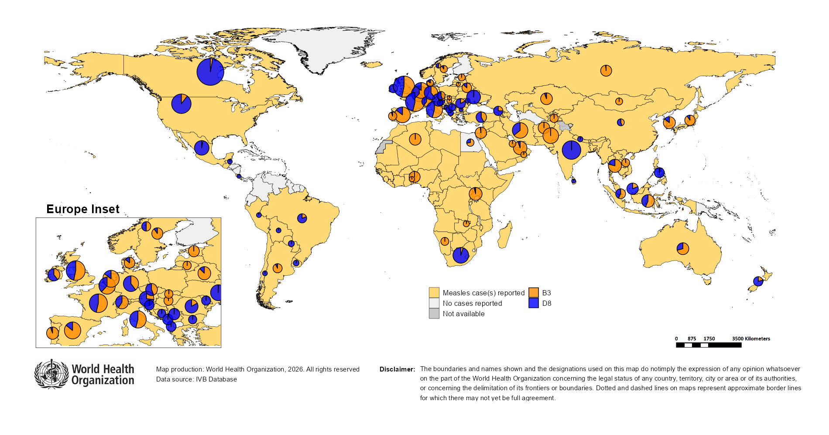
Distribution of measles genotypes (last 12 months)
Data Source: MeaNS2 database (Genotypes) and IVB Database (Incidence) as of 2026-03-16 and covering the period between 2025-02 and 2026-01 - Pie charts proportional to the number of sequenced viruses

Slide 38
Rubella

Slide 39
Number of reported rubella cases by WHO Region
2026
Region | Member States* | Rubella cases | Clin | Epi | Lab | Date Received
AFR | 33/47 | 1,514 | 0 | 0 | 1,514 | 2026-03
AMR | 13/35 | 0 | 0 | 0 | 0 | 2026-03
EMR | 16/21 | 78 | 0 | 0 | 78 | 2026-03
EUR | 21/53 | 2 | 1 | 0 | 1 | 2026-03
SEAR | 7/10 | 202 | 0 | 0 | 202 | 2026-03
WPR | 7/28 | 46 | 13 | 0 | 33 | 2026-03
Total | 97/194 | 1,842 | 14 | 0 | 1,828
Region | Jan | Feb | Mar | Apr | May | Jun | Jul | Aug | Sep | Oct | Nov | Dec
AFR | 1,180 | 334 | 0 | 0 | 0 | 0 | 0 | 0 | 0 | 0 | 0 | 0
AMR | 0 | 0 | 0 | 0 | 0 | 0 | 0 | 0 | 0 | 0 | 0 | 0
EMR | 73 | 5 | 0 | 0 | 0 | 0 | 0 | 0 | 0 | 0 | 0 | 0
EUR | 2 | 0 | 0 | 0 | 0 | 0 | 0 | 0 | 0 | 0 | 0 | 0
SEAR | 160 | 42 | 0 | 0 | 0 | 0 | 0 | 0 | 0 | 0 | 0 | 0
WPR | 24 | 22 | 0 | 0 | 0 | 0 | 0 | 0 | 0 | 0 | 0 | 0
Total | 1,439 | 403 | 0 | 0 | 0 | 0 | 0 | 0 | 0 | 0 | 0 | 0
2025
Region | Member States* | Rubella cases | Clin | Epi | Lab | Date Received
AFR | 42/47 | 12,941 | 0 | 0 | 12,941 | 2026-03
AMR | 27/35 | 3 | 0 | 0 | 3 | 2026-03
EMR | 20/21 | 2,515 | 1,917 | 15 | 583 | 2026-03
EUR | 31/53 | 537 | 93 | 6 | 438 | 2026-03
SEAR | 10/10 | 2,747 | 0 | 81 | 2,666 | 2026-03
WPR | 15/28 | 1,702 | 50 | 0 | 1,652 | 2026-03
Total | 145/194 | 20,445 | 2,060 | 102 | 18,283
Region | Jan | Feb | Mar | Apr | May | Jun | Jul | Aug | Sep | Oct | Nov | Dec
AFR | 735 | 1,232 | 1,458 | 1,238 | 874 | 577 | 487 | 732 | 1,417 | 1,876 | 1,398 | 917
AMR | 0 | 0 | 0 | 0 | 0 | 2 | 1 | 0 | 0 | 0 | 0 | 0
EMR | 278 | 421 | 343 | 326 | 250 | 157 | 146 | 118 | 93 | 146 | 161 | 76
EUR | 108 | 84 | 77 | 71 | 54 | 47 | 28 | 13 | 13 | 21 | 9 | 12
SEAR | 255 | 268 | 253 | 274 | 264 | 247 | 218 | 192 | 195 | 197 | 203 | 181
WPR | 148 | 184 | 159 | 164 | 142 | 156 | 161 | 191 | 188 | 138 | 46 | 25
Total | 1,524 | 2,189 | 2,290 | 2,073 | 1,584 | 1,186 | 1,041 | 1,246 | 1,906 | 2,378 | 1,817 | 1,211
Notes: Based on data received 2026-03 - This is surveillance data, hence for the last month, the data may be incomplete. * Member States Reporting / Total Member States in Region

Slide 40
Rubella case distribution by month and WHO Region (2018-2026)
2018
2019
2020
2021
2022
2023
2024
2025
2026
17,045 cases
47,766 cases
7,501 cases
7,410 cases
12,822 cases
10,421 cases
23,382 cases
20,445 cases
1,842 cases
9,000
AFR
AMR
6,000
EMR
EUR
SEAR
WPR
3,000
0
May
Sep
Sep
Sep
Sep
Sep
Sep
Sep
Sep
Sep
Apr
Aug
May
Aug
May
Aug
May
Aug
May
Aug
May
Aug
May
Aug
May
Aug
May
Aug
Jan
Jun
Jul
Oct
Jan
Apr
Jun
Jul
Oct
Jan
Apr
Jun
Jul
Oct
Jan
Apr
Jun
Jul
Oct
Jan
Apr
Jun
Jul
Oct
Jan
Apr
Jun
Jul
Oct
Jan
Apr
Jun
Jul
Oct
Jan
Apr
Jun
Jul
Oct
Jan
Apr
Jun
Jul
Oct
Feb
Mar
Nov
Dec
Feb
Mar
Nov
Dec
Feb
Mar
Nov
Dec
Feb
Mar
Nov
Dec
Feb
Mar
Nov
Dec
Feb
Mar
Nov
Dec
Feb
Mar
Nov
Dec
Feb
Mar
Nov
Dec
Feb
Mar
Nov
Dec
Based on data received 2026-03 - Data Source: IVB Database - This is surveillance data, hence for the last month(s), the data may be incomplete.

Slide 41
Rubella case distribution by month and WHO Region (2024-2026)
2024
2025
2026
23,382 cases
20,445 cases
1,842 cases
5,000
4,000
AFR
3,000
AMR
EMR
EUR
SEAR
2,000
WPR
1,000
0
Jan
Feb
Mar
Apr
May
Jun
Jul
Aug
Sep
Oct
Nov
Dec
Jan
Feb
Mar
Apr
May
Jun
Jul
Aug
Sep
Oct
Nov
Dec
Jan
Feb
Mar
Apr
May
Jun
Jul
Aug
Sep
Oct
Nov
Dec
Based on data received 2026-03 - Data Source: IVB Database - This is surveillance data, hence for the last month(s), the data may be incomplete.

Slide 42
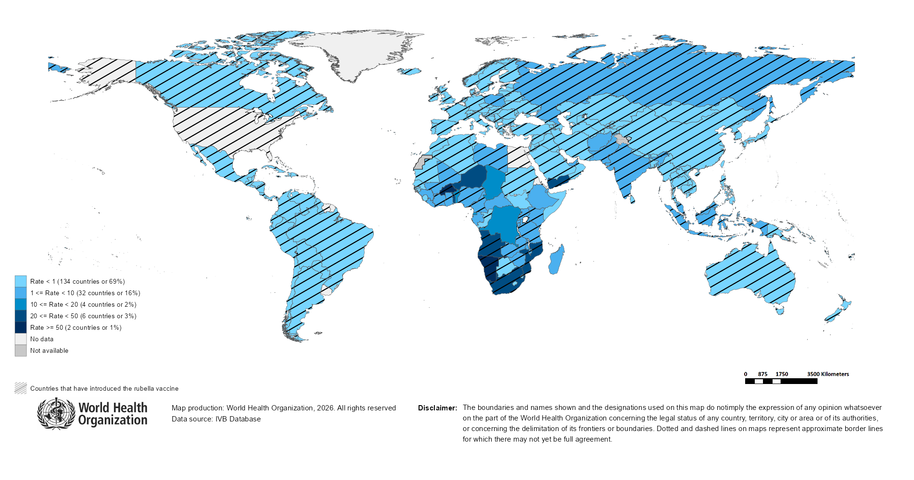
Rubella Incidence Rate per Million (12M period)
Highest incidence rates | Highest incidence rates | Highest incidence rates
Country | Cases | Rate
Burkina Faso | 1849 | 76.80
Namibia | 202 | 65.31
Angola | 1765 | 45.21
Yemen | 1759 | 42.11
Niger | 840 | 30.09
Togo | 227 | 23.35
South Africa | 1497 | 23.12
Mozambique | 814 | 22.84
Benin | 276 | 18.63
DR Congo | 2031 | 18.00
Notes: Based on data received 2026-03 - Surveillance data from 2025-08 to 2026-01 - Incidence: Number of cases / population * 1,000,000 - Population data: World population prospects, 2019 revision

Slide 43
Disclaimer
This document contains data provided to WHO by member states. Note that some member states only provide aggregate data to WHO, and for these, we are unable to generate a country profile. Some member states report all cases at one time point for the entire year, and thus epidemiologic curves generated are not accurate and a reporting artifact. For some countries, cases are reported by age category, not by exact age in months and/or years. Thus, age distribution/incidence is approximate. Cases classified as pending by countries are classified at WHO as clinically compatible at this time, and thus numbers might different between data shown here and provided by the member state or WHO country/regional offices.
*UN population data is used as the denominator for calculating incidence.

Slide 44
Rubella cases (AFR)
AFR Rubella Case Distribution (January 2024-March 2026)
Top 10 countries (last 12 M) | Top 10 countries (last 12 M) | Top 10 countries (last 12 M) | Top 10 countries (last 12 M)
Country | RCV in RI | Cases | % of Total
DR Congo | No | 2026 | 16
Nigeria | 2025 | 1907 | 15
Angola | 2018 | 1831 | 15
Burkina Faso | 2015 | 1806 | 14
South Africa | 2024 | 1481 | 12
Others | - | 1220 | 10
Mozambique | 2018 | 775 | 6
Niger | No | 626 | 5
Ethiopia | No | 350 | 3
Togo | 2018 | 267 | 2
Namibia | 2016 | 199 | 2
2024
2025
2026
4,000
3,000
(lab + epi-linked + clinical)
Number of cases
2,000
1,000
0
Jan
Feb
Mar
Apr
May
Jun
Jul
Aug
Sep
Oct
Nov
Dec
Jan
Feb
Mar
Apr
May
Jun
Jul
Aug
Sep
Oct
Nov
Dec
Jan
Feb
Mar
Apr
May
Jun
Jul
Aug
Sep
Oct
Nov
Dec
Introduced less than 5 years ago
Introduced more than 5 years ago
Not introduced in EPI
(after 2021)
(2021 and before)
AFR Age distribution of Rubella IgM+ cases by vaccine introduction status in the National EPI Programme (last 12 Months)
1000
(IgM+ only)
Number of cases
500
0
0
10
20
30
40
Age at onset (in years)
Rubella vaccine introduced before 1 January 2026
Rubella vaccine not introduced before 1 January 2026
Notes: Based on data received 2026-03 Data Source: IVB Database.

Slide 45
Rubella cases: Democratic Republic of the Congo
ELIMINATION STATUS:
ENDEMIC
2023
2024
2025
2026
800
Total = 1,728 cases
Total = 594 cases
Total = 300 cases
Total = 336 cases
600
400
Rubella cases
200
0
Jan
Feb
Mar
Apr
May
Jun
Jul
Aug
Sep
Oct
Nov
Dec
Jan
Feb
Mar
Apr
May
Jun
Jul
Aug
Sep
Oct
Nov
Dec
Jan
Feb
Mar
Apr
May
Jun
Jul
Aug
Sep
Oct
Nov
Dec
Jan
Feb
Mar
Apr
May
Jun
Jul
Aug
Sep
Oct
Nov
Dec
SIA
Clinical
Epi
Lab
Age distribution, sex and incidence (Last 12 months)
WHO/UNICEF Coverage Estimates (WUENIC)
1,000
100
750
60
80
40
Number of cases
500
Incidence rate per M
60
20
% Coverage
250
40
0
0
20
<1 yr
1-4 yrs
5-9 yrs
10-14 yrs
15-24 yrs
25-39 yrs
40+ yrs
0
Age at onset (in years)
2000
2001
2002
2003
2004
2005
2006
2007
2008
2009
2010
2011
2012
2013
2014
2015
2016
2017
2018
2019
2020
2021
2022
2023
2024
Incidence
Male
Female
Unknown
RCV1

Slide 46
Rubella cases: Ethiopia
ELIMINATION STATUS:
ENDEMIC
300
2023
2024
2025
2026
Total = 930 cases
Total = 242 cases
Total = 445 cases
Total = 21 cases
200
Rubella cases
100
0
Jan
Feb
Mar
Apr
May
Jun
Jul
Aug
Sep
Oct
Nov
Dec
Jan
Feb
Mar
Apr
May
Jun
Jul
Aug
Sep
Oct
Nov
Dec
Jan
Feb
Mar
Apr
May
Jun
Jul
Aug
Sep
Oct
Nov
Dec
Jan
Feb
Mar
Apr
May
Jun
Jul
Aug
Sep
Oct
Nov
Dec
Clinical
Epi
Lab
Age distribution, sex and incidence (Last 12 months)
WHO/UNICEF Coverage Estimates (WUENIC)
12
100
150
8
80
100
Incidence rate per M
60
Number of cases
50
4
% Coverage
40
0
0
20
<1 yr
1-4 yrs
5-9 yrs
10-14 yrs
15-24 yrs
25-39 yrs
40+ yrs
0
Age at onset (in years)
2000
2001
2002
2003
2004
2005
2006
2007
2008
2009
2010
2011
2012
2013
2014
2015
2016
2017
2018
2019
2020
2021
2022
2023
2024
Incidence
Male
Female
Unknown
RCV1

Slide 47
Rubella cases: Nigeria
ELIMINATION STATUS:
ENDEMIC
600
2023
2024
2025
2026
Total = 740 cases
Total = 651 cases
Total = 2,479 cases
400
Rubella cases
200
0
Jan
Feb
Mar
Apr
May
Jun
Jul
Aug
Sep
Oct
Nov
Dec
Jan
Feb
Mar
Apr
May
Jun
Jul
Aug
Sep
Oct
Nov
Dec
Jan
Feb
Mar
Apr
May
Jun
Jul
Aug
Sep
Oct
Nov
Dec
Jan
Feb
Mar
Apr
May
Jun
Jul
Aug
Sep
Oct
Nov
Dec
SIA
Clinical
Epi
Lab
Age distribution, sex and incidence (Last 12 months)
WHO/UNICEF Coverage Estimates (WUENIC)
1,000
40
100
750
30
80
Number of cases
500
Incidence rate per M
60
20
% Coverage
250
10
40
0
0
20
<1 yr
1-4 yrs
5-9 yrs
10-14 yrs
15-24 yrs
25-39 yrs
40+ yrs
0
Age at onset (in years)
2000
2001
2002
2003
2004
2005
2006
2007
2008
2009
2010
2011
2012
2013
2014
2015
2016
2017
2018
2019
2020
2021
2022
2023
2024
Incidence
Male
Female
Unknown
RCV1

Slide 48
Rubella cases (EMR)
EMR Rubella Case Distribution (January 2024-March 2026)
Top 10 countries (last 12 M) | Top 10 countries (last 12 M) | Top 10 countries (last 12 M) | Top 10 countries (last 12 M)
Country | RCV in RI | Cases | % of Total
Yemen | 2015 | 1384 | 73
Pakistan | 2022 | 251 | 13
Afghanistan | No | 108 | 6
Sudan | 2024 | 35 | 2
Others | - | 25 | 1
Iraq | 1989 | 19 | 1
Iran (Islamic Republic of) | 2004 | 18 | 1
Saudi Arabia | 1982 | 16 | 1
Syrian Arab Republic | 1999 | 14 | 1
Libya | 1993 | 12 | 1
United Arab Emirates | 1985 | 12 | 1
2024
2025
2026
400
300
(lab + epi-linked + clinical)
Number of cases
200
100
0
Jan
Feb
Mar
Apr
May
Jun
Jul
Aug
Sep
Oct
Nov
Dec
Jan
Feb
Mar
Apr
May
Jun
Jul
Aug
Sep
Oct
Nov
Dec
Jan
Feb
Mar
Apr
May
Jun
Jul
Aug
Sep
Oct
Nov
Dec
Introduced less than 5 years ago
Introduced more than 5 years ago
Not introduced in EPI
(after 2021)
(2021 and before)
EMR Age distribution of Rubella IgM+ cases by vaccine introduction status in the National EPI Programme (last 12 Months)
400
300
(IgM+ only)
200
Number of cases
100
0
0
10
20
30
40
Age at onset (in years)
Rubella vaccine introduced before 1 January 2026
Rubella vaccine not introduced before 1 January 2026
Notes: Based on data received 2026-03 Data Source: IVB Database.

Slide 49
Rubella cases: Pakistan
ELIMINATION STATUS:
ENDEMIC
2023
2024
2025
2026
60
Total = 236 cases
Total = 330 cases
Total = 252 cases
Total = 51 cases
40
Rubella cases
20
0
Jan
Feb
Mar
Apr
May
Jun
Jul
Aug
Sep
Oct
Nov
Dec
Jan
Feb
Mar
Apr
May
Jun
Jul
Aug
Sep
Oct
Nov
Dec
Jan
Feb
Mar
Apr
May
Jun
Jul
Aug
Sep
Oct
Nov
Dec
Jan
Feb
Mar
Apr
May
Jun
Jul
Aug
Sep
Oct
Nov
Dec
Clinical
Epi
Lab
Age distribution, sex and incidence (Last 12 months)
WHO/UNICEF Coverage Estimates (WUENIC)
120
100
90
15
80
60
10
Number of cases
Incidence rate per M
60
5
% Coverage
30
40
0
0
20
<1 yr
1-4 yrs
5-9 yrs
10-14 yrs
15-24 yrs
25-39 yrs
40+ yrs
0
Age at onset (in years)
2000
2001
2002
2003
2004
2005
2006
2007
2008
2009
2010
2011
2012
2013
2014
2015
2016
2017
2018
2019
2020
2021
2022
2023
2024
Incidence
Male
Female
Unknown
RCV1

Slide 50
Rubella cases (EUR)
EUR Rubella Case Distribution (January 2024-March 2026)
Top 10 countries (last 12 M) | Top 10 countries (last 12 M) | Top 10 countries (last 12 M) | Top 10 countries (last 12 M)
Country | RCV in RI | Cases | % of Total
Russian Federation | 2000 | 233 | 67
Poland | 1988 | 69 | 20
Türkiye | 2006 | 21 | 6
Germany | 1991 | 6 | 2
Ukraine | 2003 | 5 | 1
Italy | 1972 | 3 | 1
Kazakhstan | 2004 | 3 | 1
Others | - | 3 | 1
Spain | 1978 | 2 | 1
Azerbaijan | 2003 | 1 | 0
Finland | 1975 | 1 | 0
2024
2025
2026
90
60
(lab + epi-linked + clinical)
Number of cases
30
0
Jan
Feb
Mar
Apr
May
Jun
Jul
Aug
Sep
Oct
Nov
Dec
Jan
Feb
Mar
Apr
May
Jun
Jul
Aug
Sep
Oct
Nov
Dec
Jan
Feb
Mar
Apr
May
Jun
Jul
Aug
Sep
Oct
Nov
Dec
Introduced more than 5 years ago
(2021 and before)
EUR Age distribution of Rubella IgM+ cases by vaccine introduction status in the National EPI Programme (last 12 Months)
15
10
(IgM+ only)
Number of cases
5
0
0
10
20
30
40
Age at onset (in years)
Rubella vaccine introduced before 1 January 2026
Rubella vaccine not introduced before 1 January 2026
Notes: Based on data received 2026-03 Data Source: IVB Database. Spikes in age-distribution curve are an artifact of reporting by age bands ( 0=<1 yrs, 2=1-4 yrs, 7=5-9 yrs, 12=10-14 yrs, 17=15-19 yrs, 25=20-29 yrs, 45=30+yrs) instead of by age from some member states.

Slide 51
Rubella cases (SEAR (excl. India))
SEAR (excl. India) Rubella Case Distribution (January 2024-March 2026)
Top 10 countries (last 12 M) | Top 10 countries (last 12 M) | Top 10 countries (last 12 M) | Top 10 countries (last 12 M)
Country | RCV in RI | Cases | % of Total
Bangladesh | 2012 | 101 | 82
Thailand | 1997 | 13 | 11
Myanmar | 2015 | 8 | 7
Nepal | 2013 | 1 | 1
2024
2025
2026
20
15
(lab + epi-linked + clinical)
Number of cases
10
5
0
Jan
Feb
Mar
Apr
May
Jun
Jul
Aug
Sep
Oct
Nov
Dec
Jan
Feb
Mar
Apr
May
Jun
Jul
Aug
Sep
Oct
Nov
Dec
Jan
Feb
Mar
Apr
May
Jun
Jul
Aug
Sep
Oct
Nov
Dec
Introduced more than 5 years ago
(2021 and before)
SEAR (excl. India) Age distribution of Rubella IgM+ cases by vaccine introduction status in the National EPI Programme (last 12 Months)
60
40
(IgM+ only)
Number of cases
20
0
0
10
20
30
Age at onset (in years)
Rubella vaccine introduced before 1 January 2026
Rubella vaccine not introduced before 1 January 2026
Notes: Based on data received 2026-03 Data Source: IVB Database.

Slide 52
Rubella cases (SEAR, India)
SEAR, India Rubella Case Distribution (January 2024-March 2026)
Top 10 countries (last 12 M) | Top 10 countries (last 12 M) | Top 10 countries (last 12 M) | Top 10 countries (last 12 M)
Country | RCV in RI | Cases | % of Total
India | 2018 | 2303 | 100
2024
2025
2026
200
(lab + epi-linked + clinical)
Number of cases
100
0
Jan
Feb
Mar
Apr
May
Jun
Jul
Aug
Sep
Oct
Nov
Dec
Jan
Feb
Mar
Apr
May
Jun
Jul
Aug
Sep
Oct
Nov
Dec
Jan
Feb
Mar
Apr
May
Jun
Jul
Aug
Sep
Oct
Nov
Dec
Introduced more than 5 years ago
(2021 and before)
SEAR, India Age distribution of Rubella IgM+ cases by vaccine introduction status in the National EPI Programme (last 12 Months)
600
400
(IgM+ only)
Number of cases
200
0
0
10
20
30
40
Age at onset (in years)
Rubella vaccine introduced before 1 January 2026
Rubella vaccine not introduced before 1 January 2026
Notes: Based on data received 2026-03 Data Source: IVB Database.

Slide 53
Rubella cases: India
ELIMINATION STATUS:
ENDEMIC
2023
2024
2025
2026
400
Total = 2,930 cases
Total = 2,540 cases
Total = 2,612 cases
Total = 197 cases
300
Rubella cases
200
100
0
Jan
Feb
Mar
Apr
May
Jun
Jul
Aug
Sep
Oct
Nov
Dec
Jan
Feb
Mar
Apr
May
Jun
Jul
Aug
Sep
Oct
Nov
Dec
Jan
Feb
Mar
Apr
May
Jun
Jul
Aug
Sep
Oct
Nov
Dec
Jan
Feb
Mar
Apr
May
Jun
Jul
Aug
Sep
Oct
Nov
Dec
Clinical
Epi
Lab
Age distribution, sex and incidence (Last 12 months)
WHO/UNICEF Coverage Estimates (WUENIC)
800
30
100
600
20
80
Number of cases
Incidence rate per M
60
400
% Coverage
200
10
40
0
0
20
<1 yr
1-4 yrs
5-9 yrs
10-14 yrs
15-24 yrs
25-39 yrs
40+ yrs
0
Age at onset (in years)
2000
2001
2002
2003
2004
2005
2006
2007
2008
2009
2010
2011
2012
2013
2014
2015
2016
2017
2018
2019
2020
2021
2022
2023
2024
Incidence
Male
Female
Unknown
RCV1

Slide 54
Rubella cases (WPR)
WPR Rubella Case Distribution (January 2024-March 2026)
Top 10 countries (last 12 M) | Top 10 countries (last 12 M) | Top 10 countries (last 12 M) | Top 10 countries (last 12 M)
Country | RCV in RI | Cases | % of Total
Indonesia | 2018 | 876 | 62
China | 2008 | 366 | 26
Philippines | 2010 | 92 | 6
Malaysia | 2004 | 68 | 5
Japan | 1995 | 10 | 1
Cambodia | 2013 | 2 | 0
Lao People's Democratic Republic | 2012 | 2 | 0
200
2024
2025
2026
150
(lab + epi-linked + clinical)
100
Number of cases
50
0
Jan
Feb
Mar
Apr
May
Jun
Jul
Aug
Sep
Oct
Nov
Dec
Jan
Feb
Mar
Apr
May
Jun
Jul
Aug
Sep
Oct
Nov
Dec
Jan
Feb
Mar
Apr
May
Jun
Jul
Aug
Sep
Oct
Nov
Dec
Introduced more than 5 years ago
(2021 and before)
WPR Age distribution of Rubella IgM+ cases by vaccine introduction status in the National EPI Programme (last 12 Months)
300
200
(IgM+ only)
Number of cases
100
0
0
10
20
30
40
Age at onset (in years)
Rubella vaccine introduced before 1 January 2026
Rubella vaccine not introduced before 1 January 2026
Notes: Based on data received 2026-03 Data Source: IVB Database.

Slide 55
Rubella cases: Indonesia
ELIMINATION STATUS:
ENDEMIC
2023
2024
2025
2026
Total = 477 cases
Total = 457 cases
Total = 1,106 cases
150
100
Rubella cases
50
0
Jan
Feb
Mar
Apr
May
Jun
Jul
Aug
Sep
Oct
Nov
Dec
Jan
Feb
Mar
Apr
May
Jun
Jul
Aug
Sep
Oct
Nov
Dec
Jan
Feb
Mar
Apr
May
Jun
Jul
Aug
Sep
Oct
Nov
Dec
Jan
Feb
Mar
Apr
May
Jun
Jul
Aug
Sep
Oct
Nov
Dec
Clinical
Epi
Lab
Age distribution, sex and incidence (Last 12 months)
WHO/UNICEF Coverage Estimates (WUENIC)
400
100
300
40
80
200
Incidence rate per M
60
Number of cases
20
% Coverage
100
40
0
0
20
<1 yr
1-4 yrs
5-9 yrs
10-14 yrs
15-24 yrs
25-39 yrs
40+ yrs
0
Age at onset (in years)
2000
2001
2002
2003
2004
2005
2006
2007
2008
2009
2010
2011
2012
2013
2014
2015
2016
2017
2018
2019
2020
2021
2022
2023
2024
Incidence
Male
Female
Unknown
RCV1

Slide 56

Distribution of rubella genotypes (last 12 months)
Data Source: RUBENS2 database (Genotypes) and IVB Database (Incidence) as of 2026-03-16 and covering the period between 2025-02 and 2026-01 - Pie charts proportional to the number of sequenced viruses

Slide 57
Laboratory

Slide 58
Measles and Rubella IgM Data Summary
2026
Region | Member States* | Specimens received | Measles tested n(%) | Measles positive n(%) | Measles equivocal n(%) | Measles negative n(%) | Rubella tested | Rubella positive n(%) | Rubella equivocal n(%) | Rubella negative n(%)
AFR | 0/47 | 0 | 0 (0) | 0 (0) | 0 (0) | 0 (0) | 0 | 0 (0) | 0 (0) | 0 (0)
AMR | 12/35 | 17,699 | 17,654 (100) | 4,035 (23) | 627 (4) | 12,990 (74) | 17,009 | 508 (3) | 294 (2) | 16,201 (95)
EMR | 16/21 | 5,097 | 4,555 (89) | 1,536 (34) | 19 (0) | 3,000 (66) | 3,216 | 100 (3) | 11 (0) | 3,105 (97)
EUR | 31/53 | 1,477 | 1,271 (86) | 520 (41) | 2 (0) | 662 (52) | 893 | 400 (45) | 6 (1) | 410 (46)
SEAR | 8/10 | 8,813 | 7,666 (87) | 2,200 (29) | 149 (2) | 5,314 (69) | 7,685 | 145 (2) | 38 (0) | 7,502 (98)
WPR | 26/28 | 1,991 | 1,501 (75) | 528 (35) | 435 (29) | 461 (31) | 1,389 | 40 (3) | 16 (1) | 1,332 (96)
Total | 93/194 | 35,077 | 32,647 (93) | 8,819 (27) | 1,232 (4) | 22,427 (69) | 30,192 | 1,193 (4) | 365 (1) | 28,550 (95)
2025
Region | Member States* | Specimens received | Measles tested n(%) | Measles positive n(%) | Measles equivocal n(%) | Measles negative n(%) | Rubella tested | Rubella positive n(%) | Rubella equivocal n(%) | Rubella negative n(%)
AFR | 45/47 | 72,328 | 64,272 (89) | 21,610 (34) | 1,424 (2) | 41,236 (64) | 49,660 | 3,799 (8) | 791 (2) | 45,070 (91)
AMR | 26/35 | 11,422 | 10,587 (93) | 1,452 (14) | 313 (3) | 8,822 (83) | 9,935 | 220 (2) | 120 (1) | 9,595 (97)
EMR | 20/21 | 91,014 | 81,742 (90) | 30,960 (38) | 59 (0) | 50,723 (62) | 73,146 | 1,306 (2) | 64 (0) | 71,776 (98)
EUR | 43/53 | 52,494 | 47,098 (90) | 21,970 (47) | 177 (0) | 26,209 (56) | 23,814 | 6,287 (26) | 181 (1) | 17,069 (72)
SEAR | 10/10 | 100,015 | 99,606 (100) | 10,595 (11) | 1,112 (1) | 87,844 (88) | 99,304 | 3,015 (3) | 720 (1) | 95,527 (96)
WPR | 26/28 | 72,410 | 67,914 (94) | 22,013 (32) | 1,379 (2) | 44,497 (66) | 51,911 | 1,430 (3) | 274 (1) | 50,199 (97)
Total | 170/194 | 399,683 | 371,219 (93) | 108,600 (29) | 4,464 (1) | 259,331 (70) | 307,770 | 16,057 (5) | 2,150 (1) | 289,236 (94)
Notes: Based on data received 2026-03 - * Member States Reporting / Total Member States in Region

Slide 59
Supplementary Immunization Activities

Slide 60
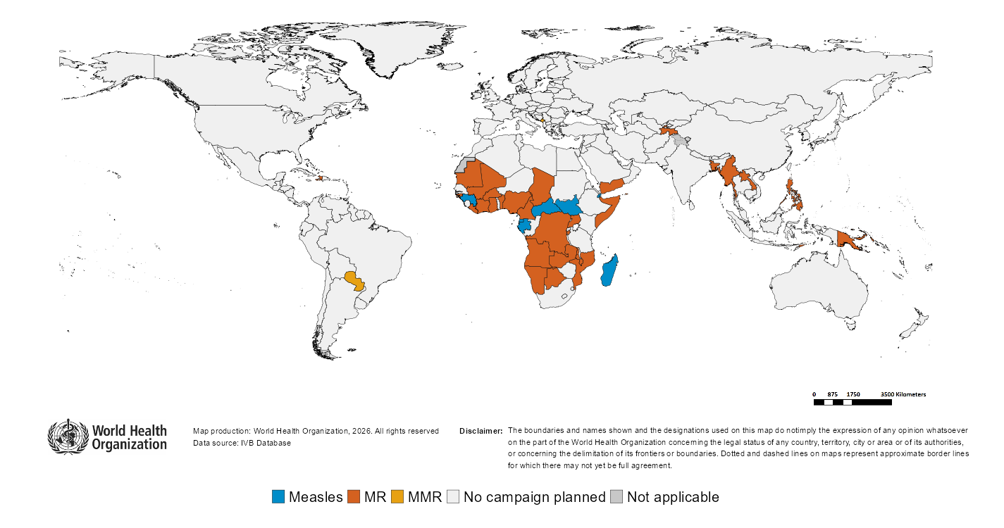
Upcoming MMR, MR and Measles campaigns (2026-2027)

Slide 61
Upcoming MMR, MR and Measles campaigns (2026-2027)
Year | Region | Name | Type | Intervention | StartDate | Status | Age Group(s) | Extent | Target
2026 | AFR | Democratic Republic of the Congo | CatchUp | MR | 2026-03-?? | Planned | 9 M-14 Y | NATIONAL | 23105951
2026 | AFR | Botswana | FollowUp | MR | 2026-05-?? | Planned | 9-59 M | NATIONAL | 148268
2026 | AFR | Democratic Republic of the Congo | CatchUp | MR | 2026-06-?? | Planned | 6 M-14 Y | NATIONAL | 24791774
2026 | AFR | Cameroon | FollowUp | MR | 2026-09-?? | Planned | 9-59 M | NATIONAL | 4345819
2026 | AFR | Burundi | FollowUp | MR | 2026-10-?? | Planned | 9-59 M | NATIONAL | 2446535
2026 | AFR | Guinea | FollowUp | MEASLES | 2026-10-?? | Planned | 9-59 M | NATIONAL | 4067987
2026 | AFR | Madagascar | FollowUp | MEASLES | 2026-10-?? | Planned | 9-59 M | NATIONAL | 4765314
2026 | AFR | Uganda | FollowUp | MR | 2026-11-?? | Planned | 9-59 M | NATIONAL | 7685529
2026 | AFR | Angola | FollowUp | MR | 2026-NA-?? | Planned | 9 M-10 Y | NATIONAL | 5983408
2026 | AFR | Gabon | FollowUp | MEASLES | 2026-NA-?? | Planned | 9-59 M | NATIONAL | 306528
2026 | AFR | Malawi | FollowUp | MR | 2026-NA-?? | Planned | 9 M-9 Y | NATIONAL | 5854405
2026 | AFR | Namibia | FollowUp | MR | 2026-NA-?? | Planned | - | - | -
2026 | AMR | Haiti | FollowUp | MR | 2026-06-?? | Planned | 9-59 M | NATIONAL | 1174657
2026 | AMR | Paraguay | Campaign | MMR | 2026-10-?? | Planned | 12-59 M | NATIONAL | 509698
2026 | EMR | Yemen | FollowUp | MR | 2026-09-?? | Planned | 6-59 M | NATIONAL | 4714060
2026 | EUR | Montenegro | CatchUp-SIA | MMR | 2026-04-?? | Planned | 1-15 Y | NATIONAL | 24000
2026 | EUR | Tajikistan | FollowUp | MR | 2026-10-?? | Planned | 9-59 M | SUBNATIONAL | 818399
2026 | SEAR | Bangladesh | FollowUp | MR | 2026-04-?? | Planned | 9 M-14 Y | NATIONAL | 19808176
2026 | SEAR | Myanmar | FollowUp | MR | 2026-11-?? | Planned | 9-59 M | NATIONAL | 2826984
2026 | WPR | Philippines | FollowUp | MR | 2026-NA-?? | Planned | 6-59 M | NATIONAL | 11922969
2027 | AFR | Benin | Followup | MR | 2027-NA-?? | Planned | 9-59 M | NATIONAL | 2136671
2027 | AFR | Burkina Faso | FollowUp | MR | 2027-NA-?? | Planned | 9-59 M | - | 3567730
2027 | AFR | Central African Republic | FollowUp | MEASLES | 2027-NA-?? | Planned | 9-59 M | NATIONAL | 984810
2027 | AFR | Chad | CatchUp | MR | 2027-NA-?? | Planned | 9 M-10 Y | NATIONAL | 4912660
2027 | AFR | Côte d'Ivoire | FollowUp | MR | 2027-NA-?? | Planned | 9-59 M | NATIONAL | 4202048
2027 | AFR | Equatorial Guinea | FollowUp | MEASLES | 2027-NA-?? | Planned | 9-59 M | NATIONAL | 229691
2027 | AFR | Ghana | FollowUp | MR | 2027-NA-?? | Planned | 9-59 M | NATIONAL | 4306120
2027 | AFR | Guinea-Bissau | FollowUp | MR | 2027-NA-?? | Planned | 9-59 M | NATIONAL | 295173
2027 | AFR | Liberia | CatchUp | MR | 2027-NA-?? | Planned | 9 M-10 Y | NATIONAL | 1277970
2027 | AFR | Mali | FollowUp | MR | 2027-NA-?? | Planned | 9-59 M | NATIONAL | 4004172
2027 | AFR | Mauritania | FollowUp | MR | 2027-NA-?? | Planned | 9-59 M | NATIONAL | 694681
2027 | AFR | Mozambique | FollowUp | MR | 2027-NA-?? | Planned | 9-59 M | NATIONAL | 9000000
2027 | AFR | Nigeria | FollowUp | MR | 2027-NA-?? | Planned | 9-59 M | SUBNATIONAL | 26123099
2027 | AFR | South Sudan | FollowUp | MEASLES | 2027-NA-?? | Planned | 9-59 M | NATIONAL | 1485839
2027 | AFR | Zambia | FollowUp | MR | 2027-NA-?? | Planned | 9-59 M | NATIONAL | 6335169
2027 | EMR | Djibouti | FollowUp | MEASLES | 2027-NA-?? | Planned | 9-59 M | NATIONAL | 340185
2027 | EMR | Somalia | CatchUp | MR | 2027-NA-?? | Planned | 9 M-10 Y | NATIONAL | 4838321
2027 | SEAR | Timor-Leste | FollowUp | MR | 2027-NA-?? | Planned | 9-59 M | NATIONAL | 157311
2027 | WPR | Lao People's Democratic Republic | FollowUp | MR | 2027-NA-?? | Planned | 9-59 M | NATIONAL | 789706
2027 | WPR | Papua New Guinea | FollowUp | MR | 2027-NA-?? | Planned | 9-59 M | NATIONAL | 1206503

Slide 62
WHO Bulletins and Newsletters

